Slide 1



Slide 2
MLB GROUP
Company Overview
We are the global leader in fuel equipment and automation solutions, with an established presence in over 85 countries. Our cutting-edge equipment and technologies serve more than 55,000 fuel stations worldwide, including key partnerships with industry giants such as TotalEnergies, Shell, BP, Petronas, ExxonMobil, and Chevron. With decades of expertise, we specialize in delivering reliable, innovative systems that enhance operational efficiency and safety in fueling operations and equipment for markets and convenience stores.
Commercial Coffee Machines for Convenience Retail
In addition to our fuel-related offerings, we are also a leading supplier of commercial automatic coffee machines, specifically designed to enhance efficiency and service quality in convenience stores, gas stations, and hospitality settings. These high-performance machines deliver premium, consistent coffee with minimal effort, allowing you to serve your customers quickly and reliably.

Slide 3
MLB GROUP
Coffee Equipment:
Whether your location serves high or low volumes of customers, our self-serve coffee machines are customizable for various cup sizes (small, medium, large) and can be tailored to suit your specific throughput needs.
Cost Efficiency: Reduce labor costs by automating coffee service while maintaining high standards of quality and consistency.
Customer Satisfaction: Meet the growing demand for premium, on-the-go coffee with fast, user-friendly machines that deliver a superior coffee experience.
Revenue Growth: Boost beverage sales and increase margins per cup with high-demand, easy-to-operate solutions.

Slide 4
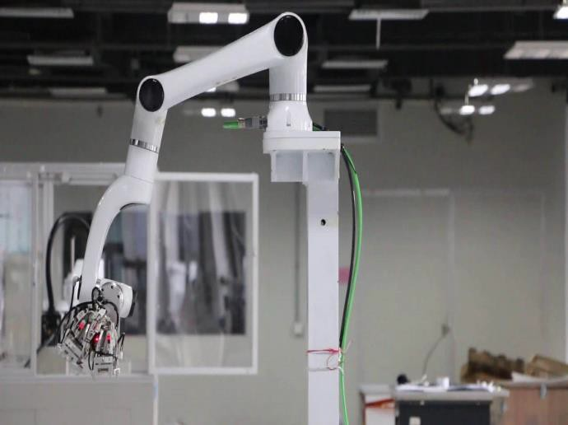
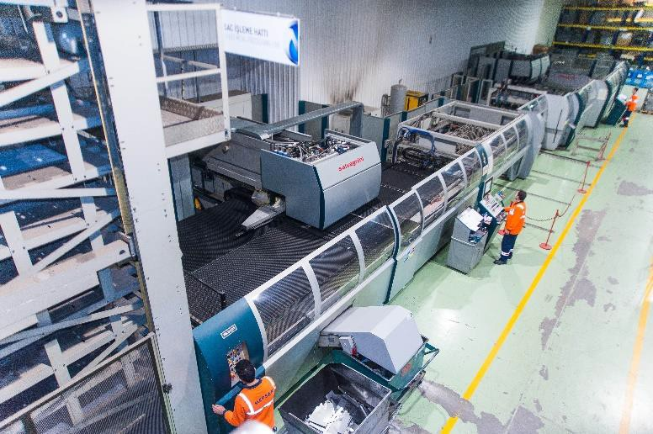
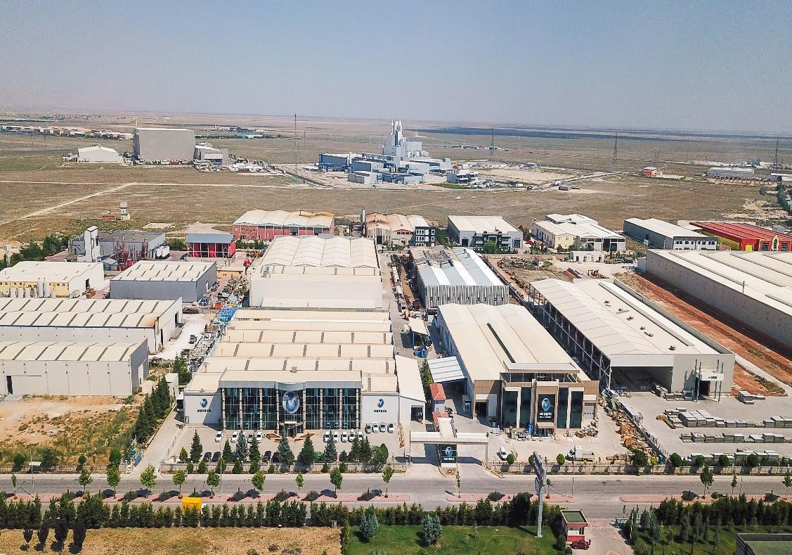
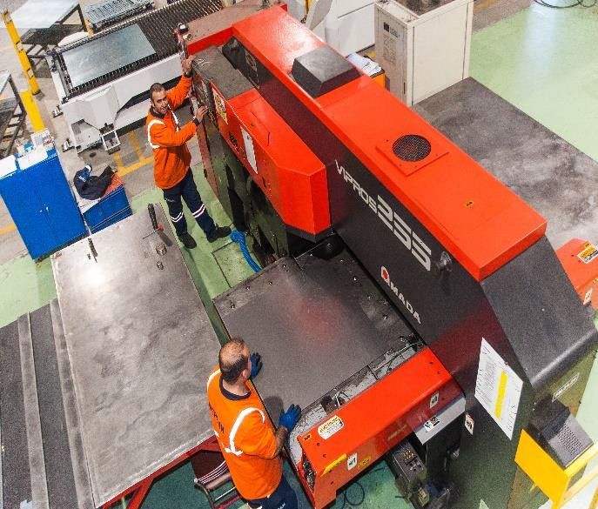
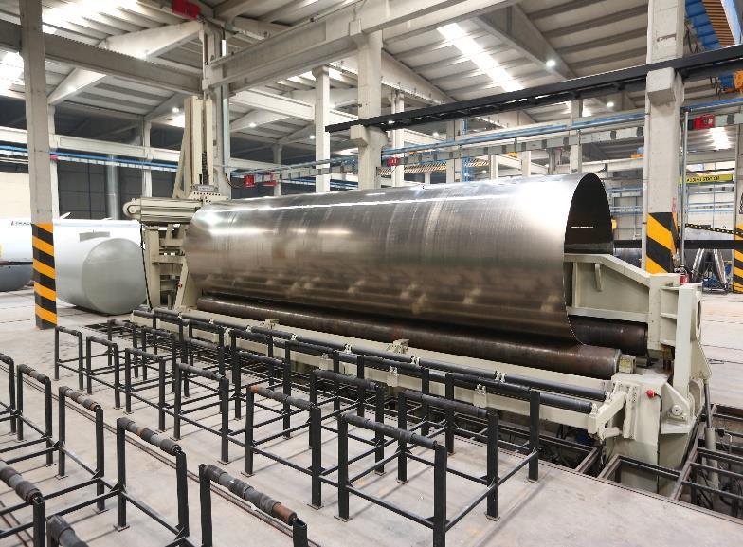
MLB Manufacturing Facilities
PRODUCTION & R-D FACILITIES, KONYA
>50.000 m2
INDOOR
>70.000 m2
TOTAL

Slide 5
CORPORATE
Vision
To be the world’s most trusted provider of innovative and cost-effective solutions, meeting the evolving needs of our customers while delivering exceptional value. We aim to become the preferred brand globally, known for our ability to solve complex challenges with creativity, efficiency, and affordability.
Mission
Our mission is to consistently deliver excellence in everything we do—creating value for our business partners, empowering innovation, and driving sustainable growth. We are committed to respecting our planet, fostering a positive impact on communities, and generating meaningful employment opportunities through our solutions.

Slide 6
MLB GROUP
Strategic Objectives:
100% Turkish Engineering: All of our solutions are designed and engineered with local expertise, ensuring precision, innovation, and quality in every product.
100% Domestic Manufacturing: We take pride in fully producing our equipment and technology within Turkey, reinforcing our commitment to local industry and ensuring high standards of craftsmanship.
Global Expansion: We aim to expand our global footprint by entering at least 5 new countries each year, broadening our reach and establishing new partnerships around the world.
Innovation Leadership: We are committed to securing at least 5 global patents annually for new products or components, showcasing our leadership in innovation and protecting the unique technology behind our solutions.
Continuous Innovation: We strive to launch 10 new innovative products each year, ensuring that we stay ahead of market trends and continue to meet the evolving needs of our customers.

Slide 7


MLB Milestones
1992
Regional Service Company in Konya
1993
First dispenser productioning
2000
New factory in Konya
2005
Head Office in Istanbul
2010
Increasing at production capacity by
%40;
Increasing at share of automation market by
%25
2014
New vision: “Leadership in integrated station solutions";
The 6 biggest brands;
SMARTLINE
2018
New investments: LEWO (LED), MEPSAN SOLARSIS (SOLAR), MEPCOGAS
(CNG PACKAGE), MPT, TRACO (ADR TANKER) MITES (MEASURING INSTRUMENTS & TRANSFER SYS.

Slide 8






MLB Group in Turkey
>200
(Mobile service in Turkey)
70.000 m²
(Manufacturing and R&D Area)
>400
(Service technician)
>550
Employees
(>300 White collars)
>50
(Authorized service)
>80
Engineer
(>60 R&D)
(>20 R&D Seniors)
>14000 stations in Turkey
(Have installed MLB products)

Slide 9
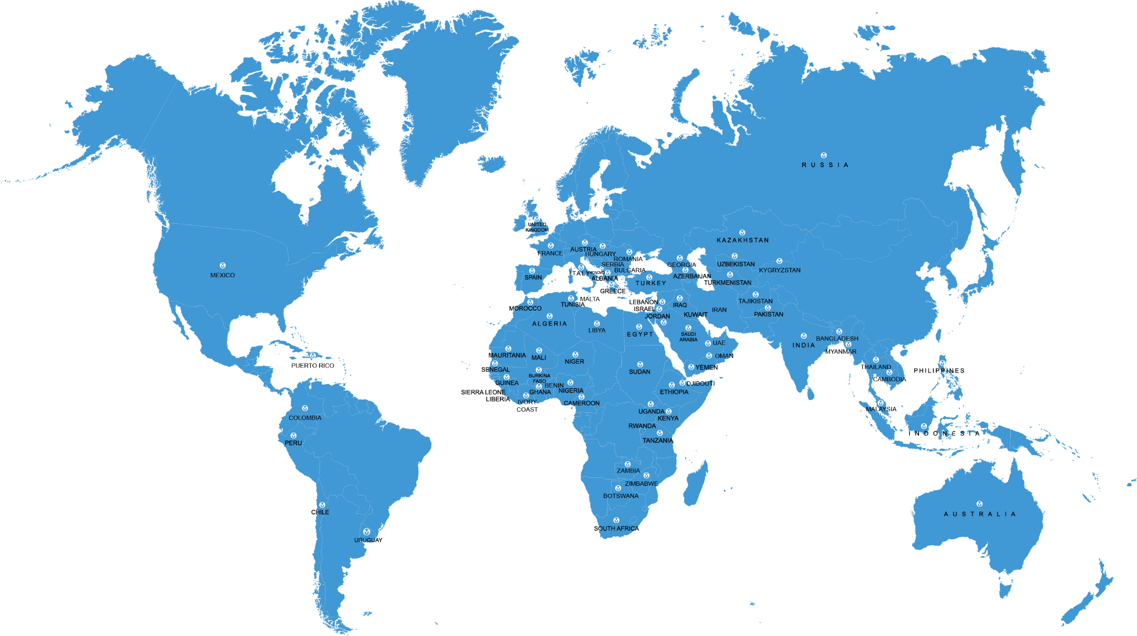

MLB Group in the World
Leadership of
market in
10
countries
Widespread distribution in
81
countries

Slide 10
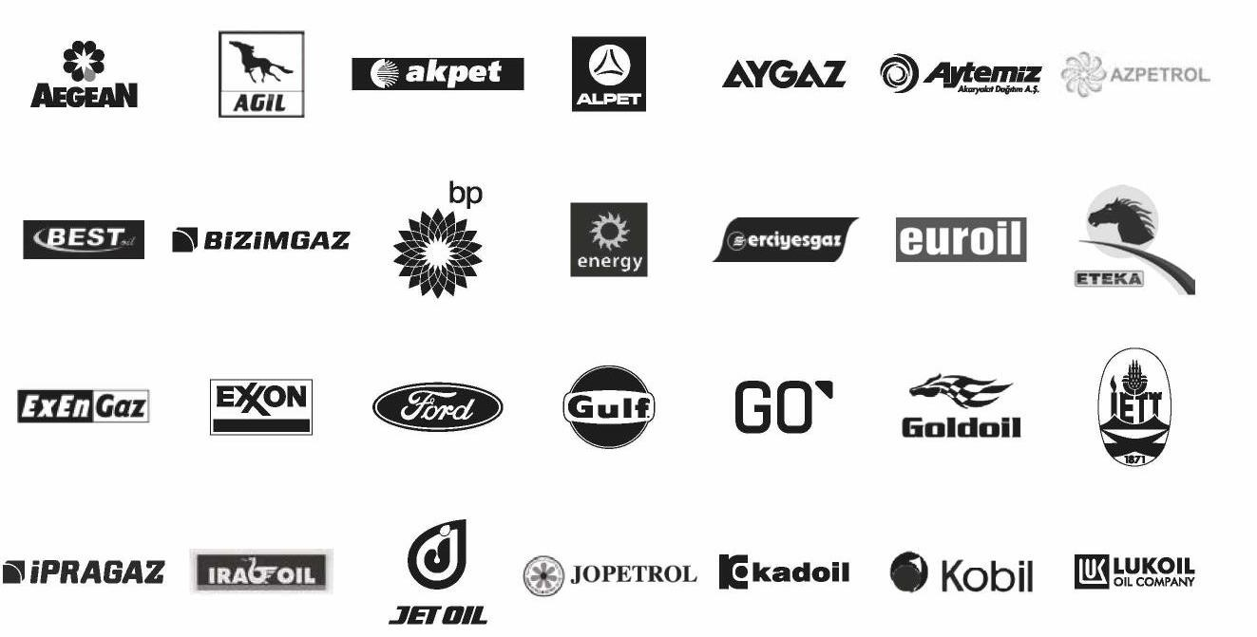
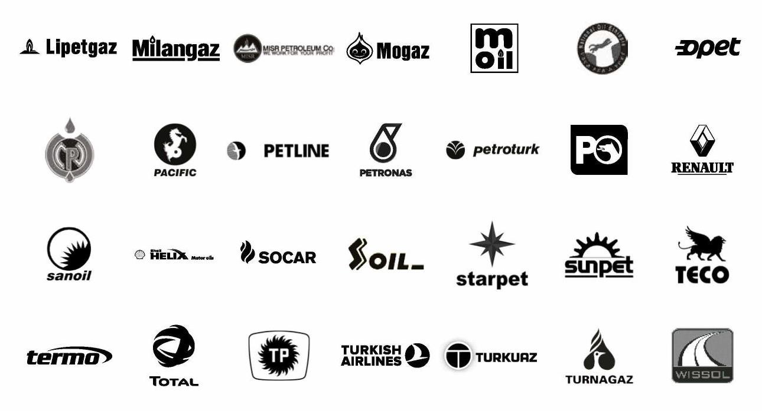
Our References

Slide 11
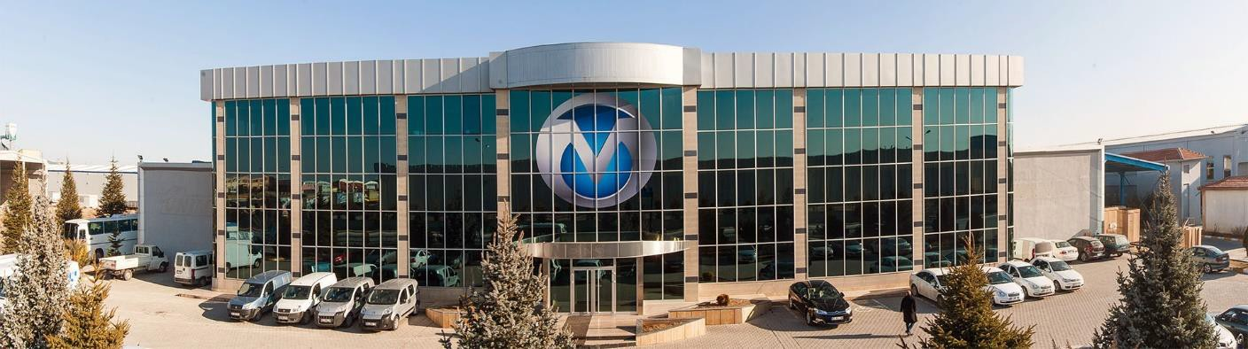




MLB Group Technology Partners
TÜBİTAK
MINISTERY OF INDUSTRY AND TECHNOLOGY
SELÇUK UNIVERSITY
MINISTERY OF ENVIRONMENT AND URBANISATION

Slide 12
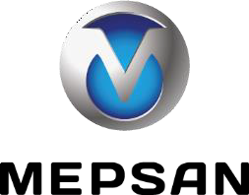






Company Union
Mepsan – Integrated Station Solutions
MPT – Environment Solutions
TRACO – Fuel / LPG Logistics & ADR Tanker
MLB R&D – Mechatronics
Mites – Tanker equipments, Quantification ve Control Devices

Slide 13









Business Areas
Environment Solutions
MLB Group R&D
Station Technologies
Automat Technologies
Automation Solutions
Carwash Technologies
Industrial Solutions
New Generation Energy Systems
Tank and Tanker Technologies

Slide 14
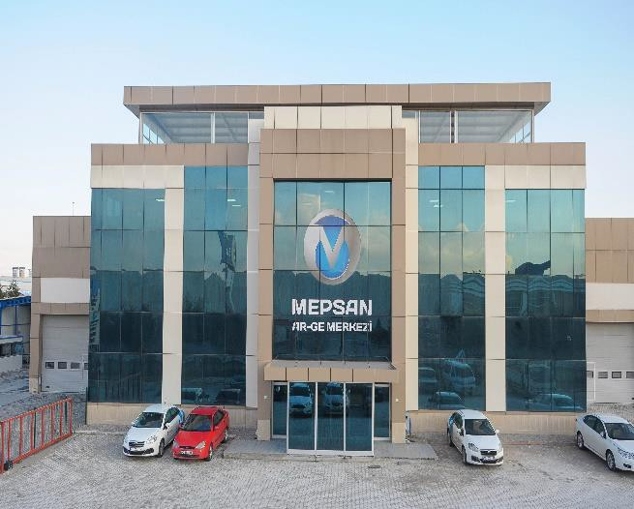
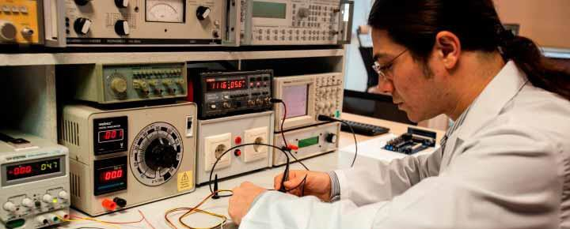
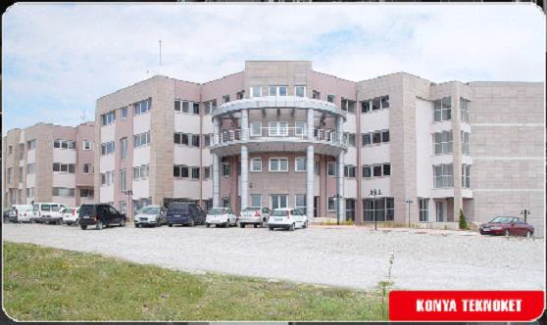
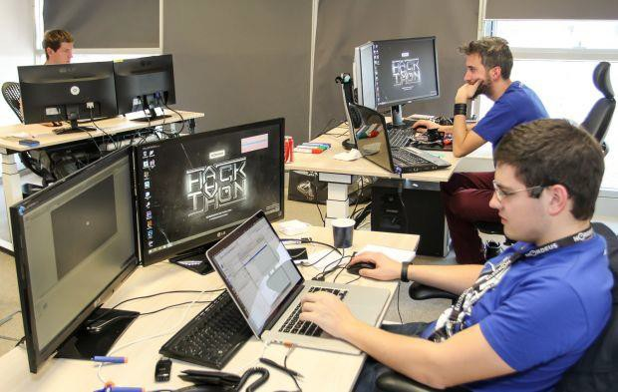
MLB Group R-D
Attributes and Achievements
Global Talent, Local Expertise: With an average employee age of 30.61, our team represents a dynamic, youthful workforce that is passionate about driving innovation and excellence. This is a unique characteristic that sets us apart on the global stage.
High Percentage of White-Collar Professionals: 35% of our workforce consists of highly skilled white-collar professionals—another unique aspect that distinguishes us in the industry. This talented group drives our continuous innovation and strategic growth.
State-of-the-Art R&D and Test Facility: Our new R&D and Test Office is dedicated to developing cutting-edge solutions, ensuring that we remain at the forefront of technological advancements. This facility is key to accelerating product innovation and improving testing protocols.
Strategic Investment in İzmir Free Zone: Our investment in the İzmir Free Zone demonstrates our commitment to boosting local industry, enhancing our manufacturing capabilities, and expanding our global presence. This strategic move allows us to optimize operations and better serve international markets.
Continuous Innovation: We maintain a consistent pipeline of new patents and intellectual property, with regular patent applications reflecting our ongoing dedication to pioneering new technologies and staying ahead of market trends.

Slide 15
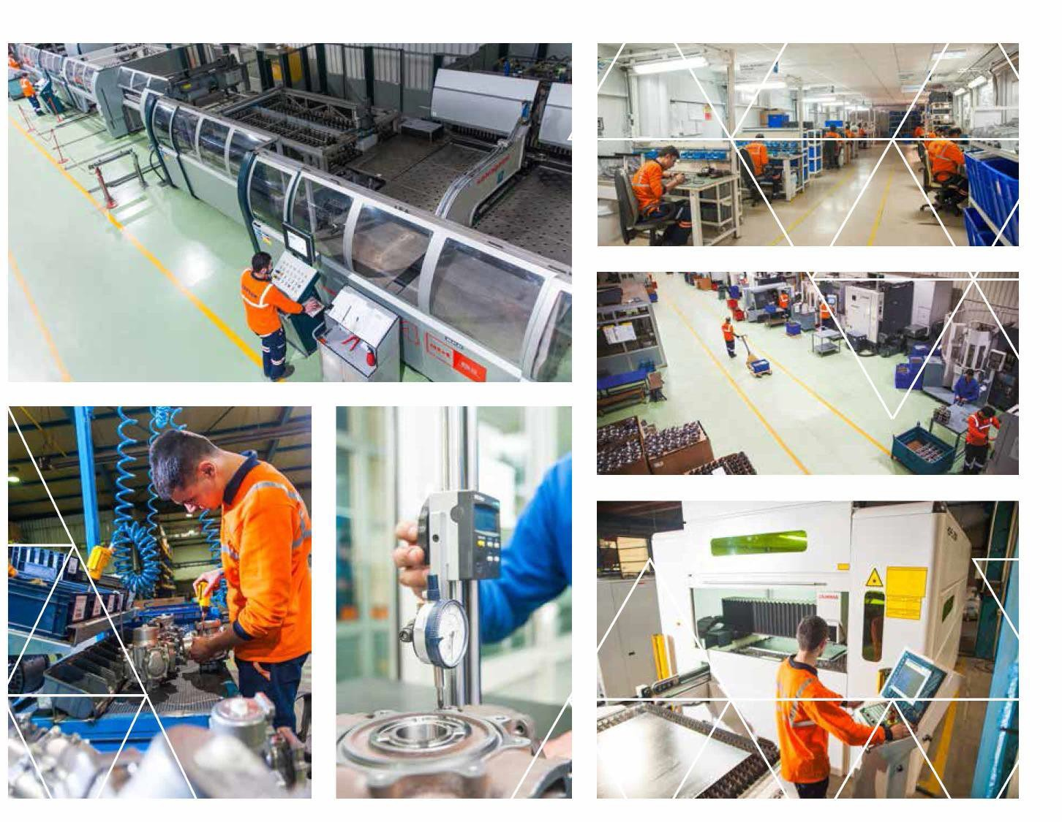
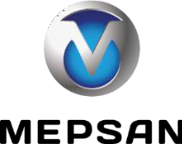
Station Technologies
Comprehensive 360° Solutions for Fuel Stations
We offer a complete 360° solution for fuel stations, providing state-of-the-art technology, equipment, and services to optimize fueling operations from end to end. Our solutions are trusted by fuel station operators worldwide, enabling them to enhance efficiency, accuracy, and customer satisfaction.
Market Leadership: With a 70% market share across Turkey's fuel sector, we dominate the industry, providing unparalleled expertise and quality to our customers.
Global Recognition: As an authorized supplier to global giants such as Total, Shell, and BP, we are recognized for our exceptional quality, innovation, and reliability.
Global Reach and Market Presence
Our products are exported to 85 countries, with a particularly dominant presence in the African market. We also enjoy a strong brand reputation in Europe, Asia, and South America, making us a trusted name across continents.
Fully Digitalized Operations: Our systems are fully integrated and digitalized, offering traceable data across both central and local structures. With cloud technology and big data integration, our operations are streamlined and transparent, ensuring the highest levels of accuracy and efficiency for our customers.

Slide 16
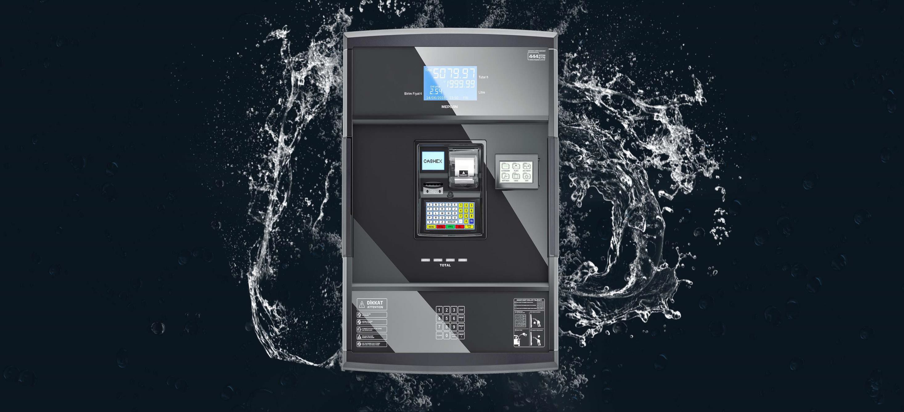

MEPSAN DISPENSERS
Station Technologies

Slide 17
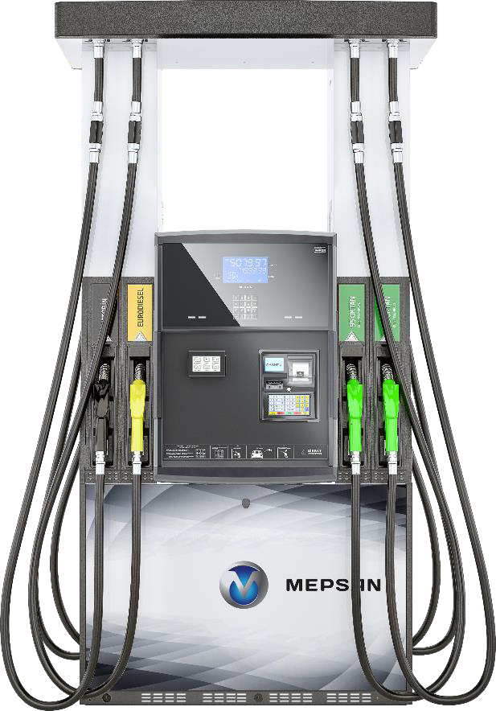
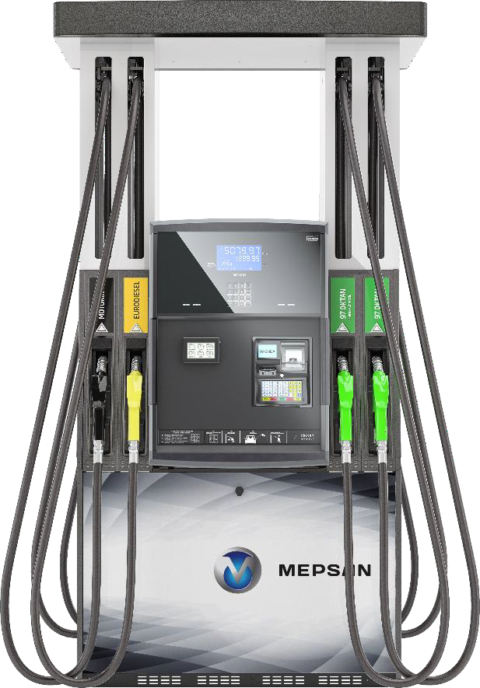
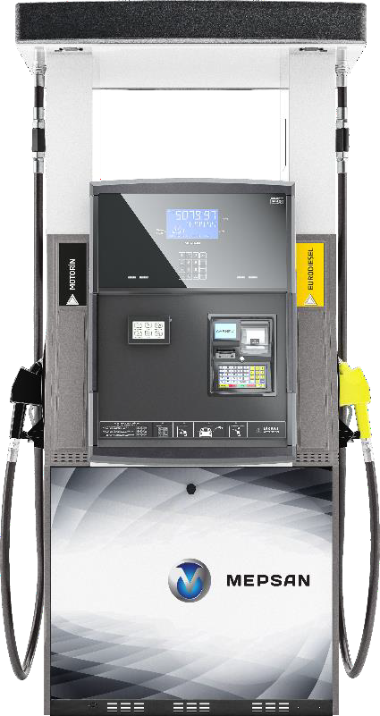
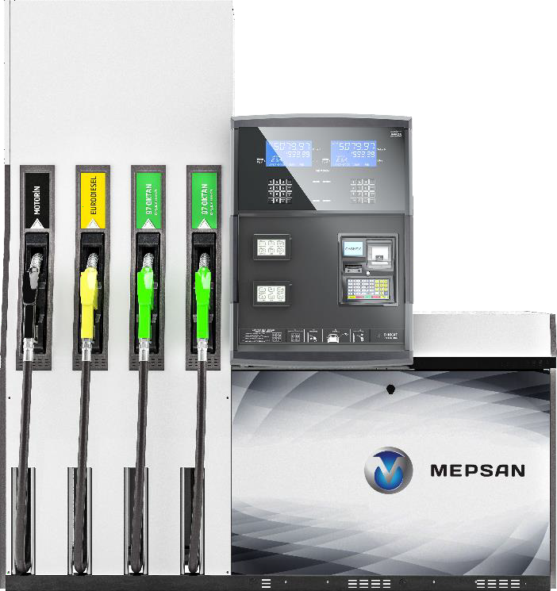
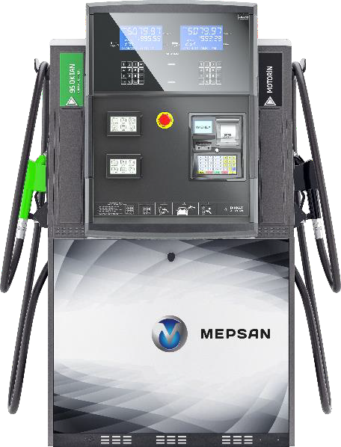
Station Technologies
SMARTLINE C
SMARTLINE R
SMARTLINE H
SMARTLINE H-X
SMARTLINE L

Slide 18
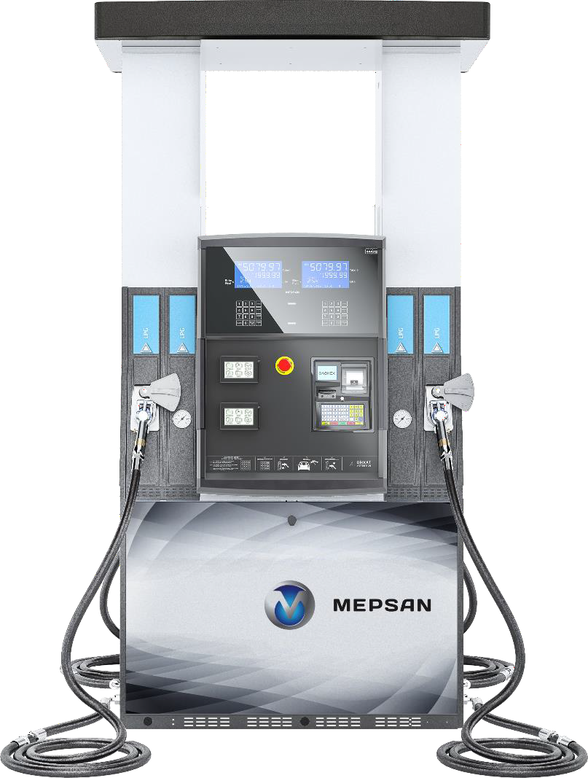
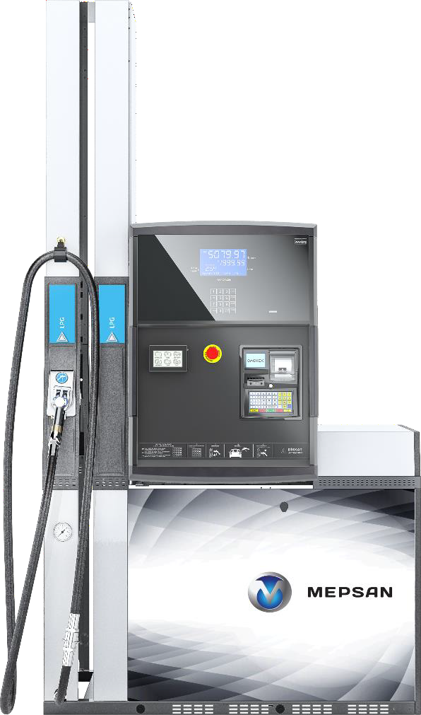
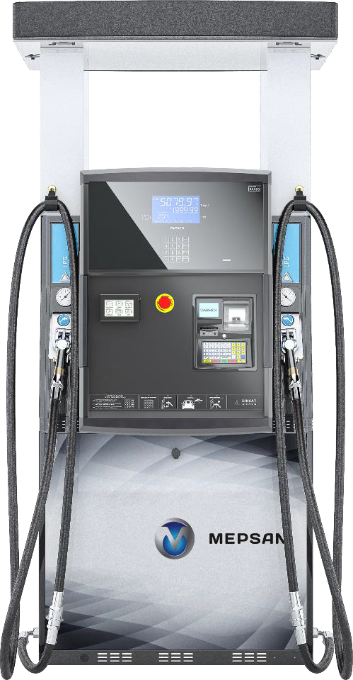
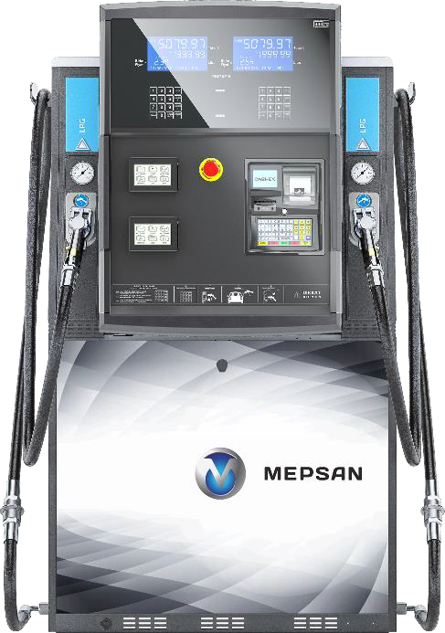
LPG
Station Technologies
SMARTLINE C
SMARTLINE R
SMARTLINE H
SMARTLINE L

Slide 19
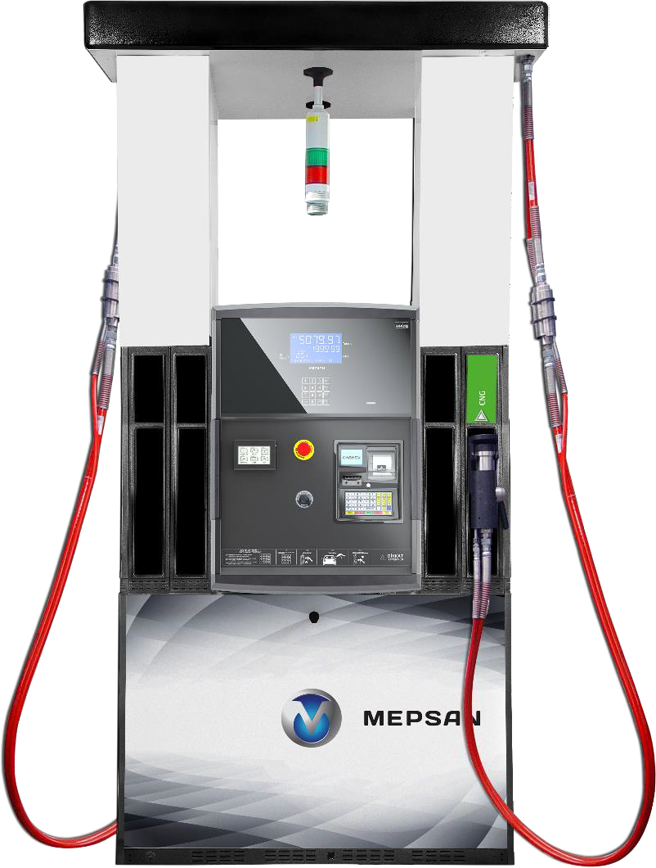
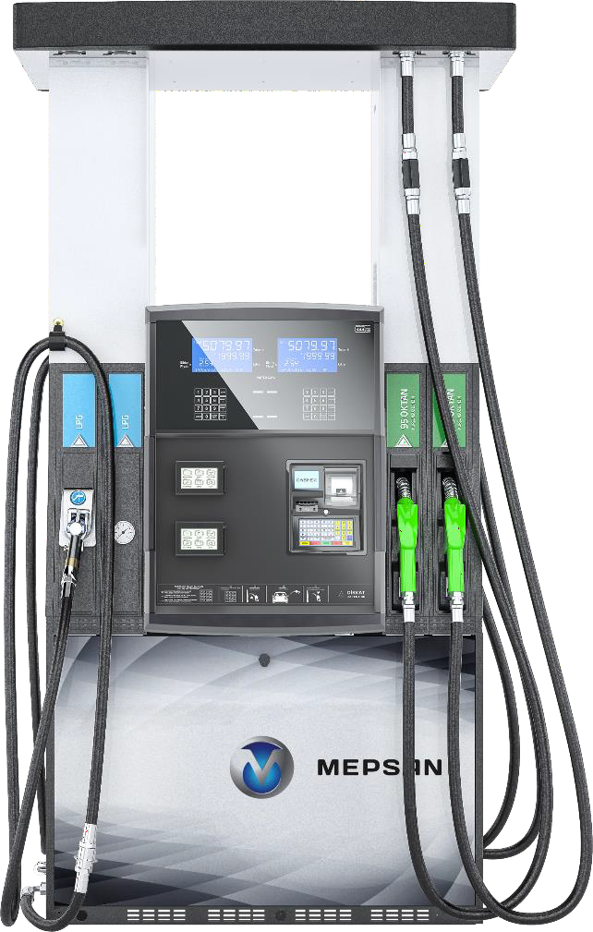
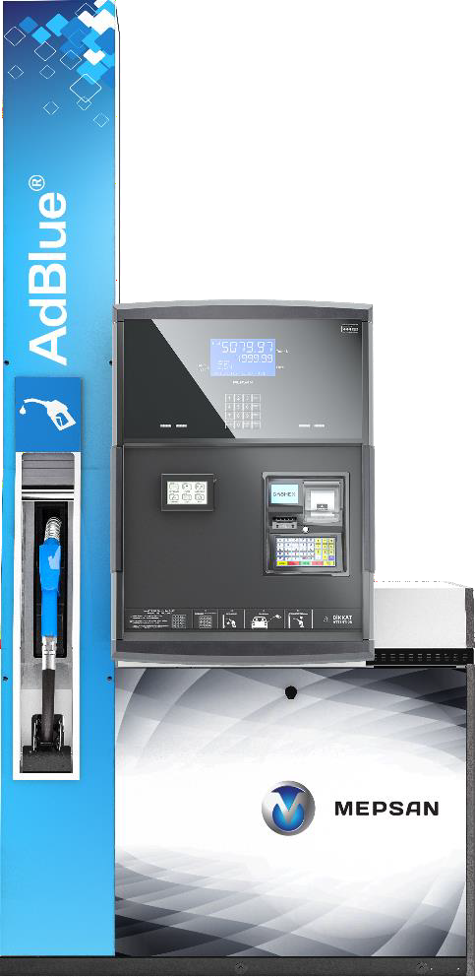
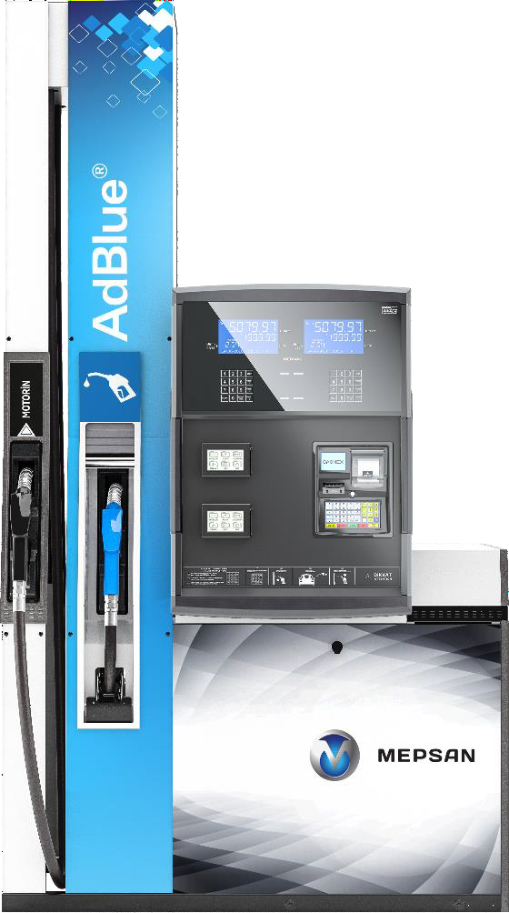
Station Technologies
SMARTLINE H
LPG-FUEL COMBO
SMARTLINE L ADBLUE
SMARTLINE L
FUEL-ADBLUE COMBO
SMARTLINE H CNG

Slide 20

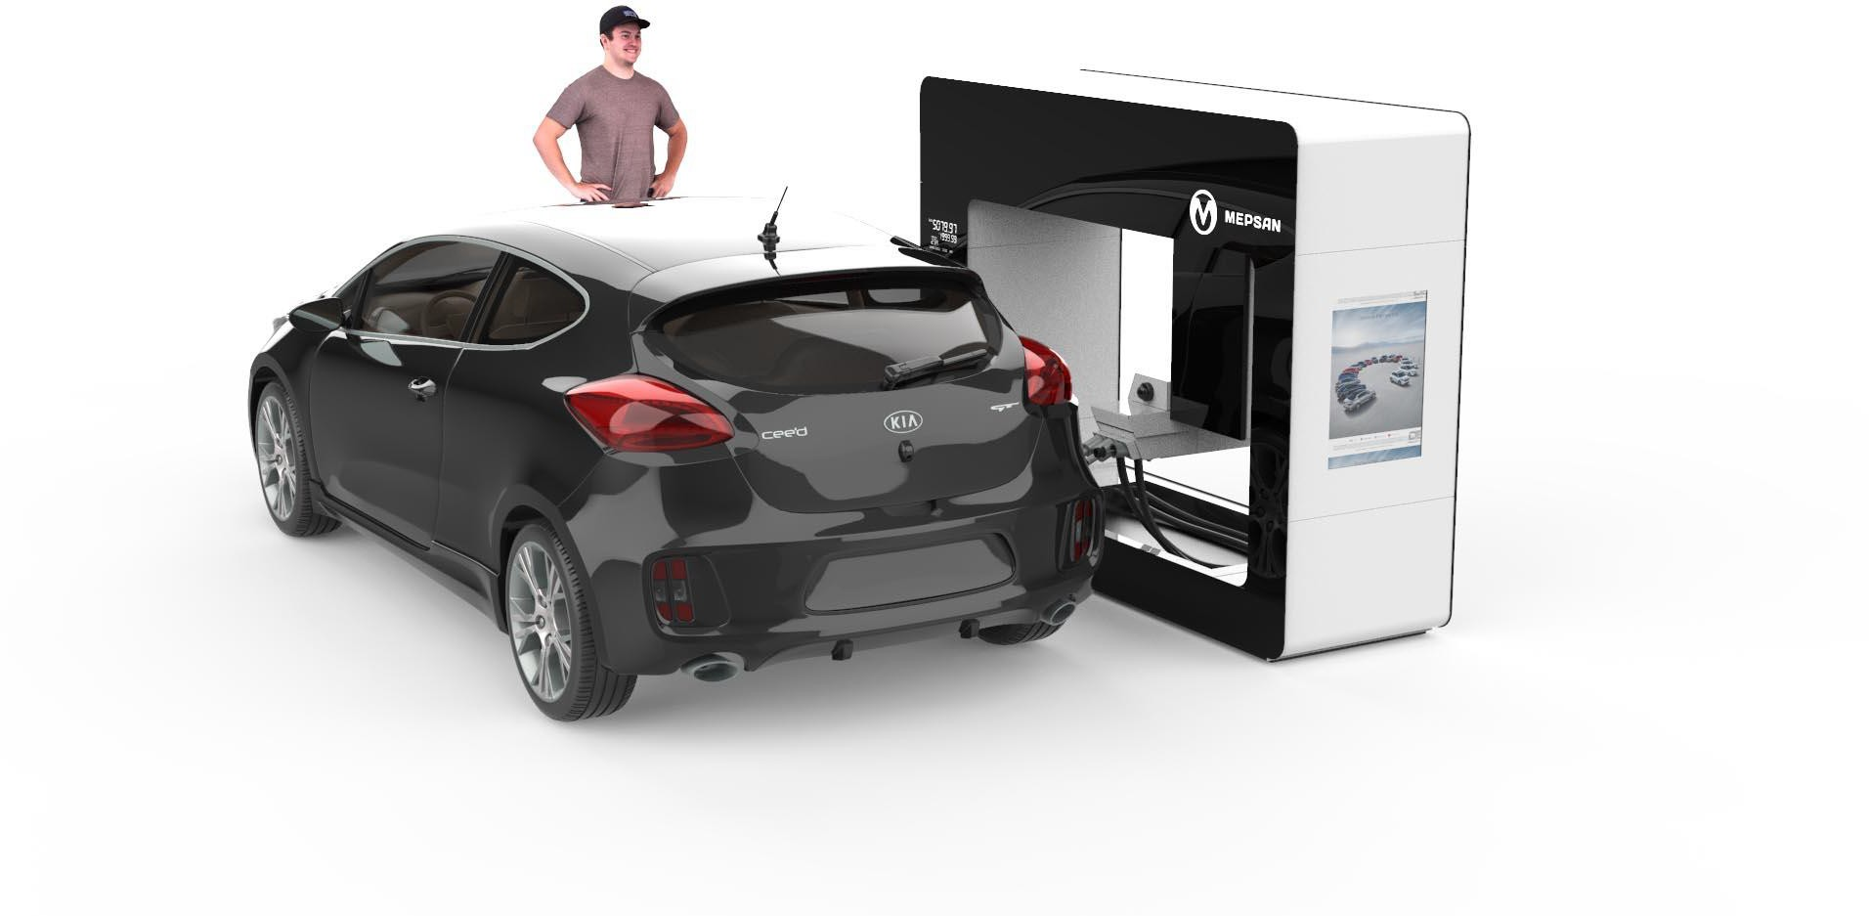
Station Technologies
ROBOLINE X

Slide 21

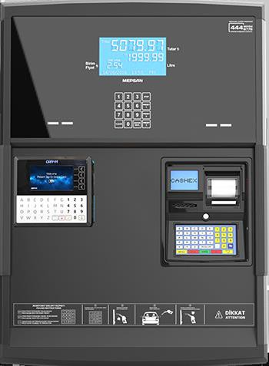
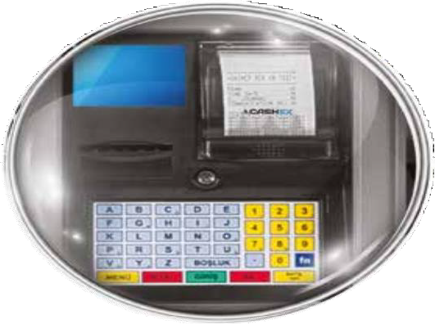
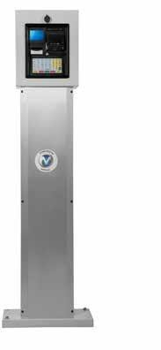
MEPSAN CASH REGISTER
Station Technologies
MEPSAN CASH REGISTER
MODELS
CASHEX OD
CASHEX OK

Slide 22

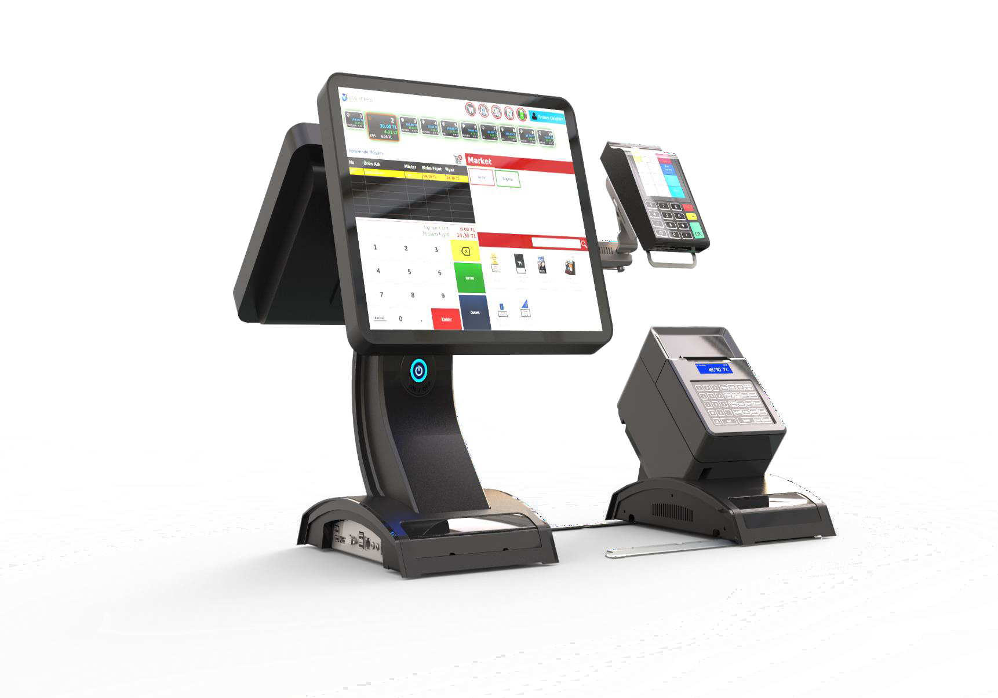

MPOS SYSTEM
Automation Solutions
CURRENT TRACKING
STOCK TRAKING
EMPLOYEE TRACKING
BANK MODULE
CASE MODULE
INCOME AND EXPENSE MODULE
FUEL MODULE
REPORTING MODULE
CAMPAING MODULE

Slide 23
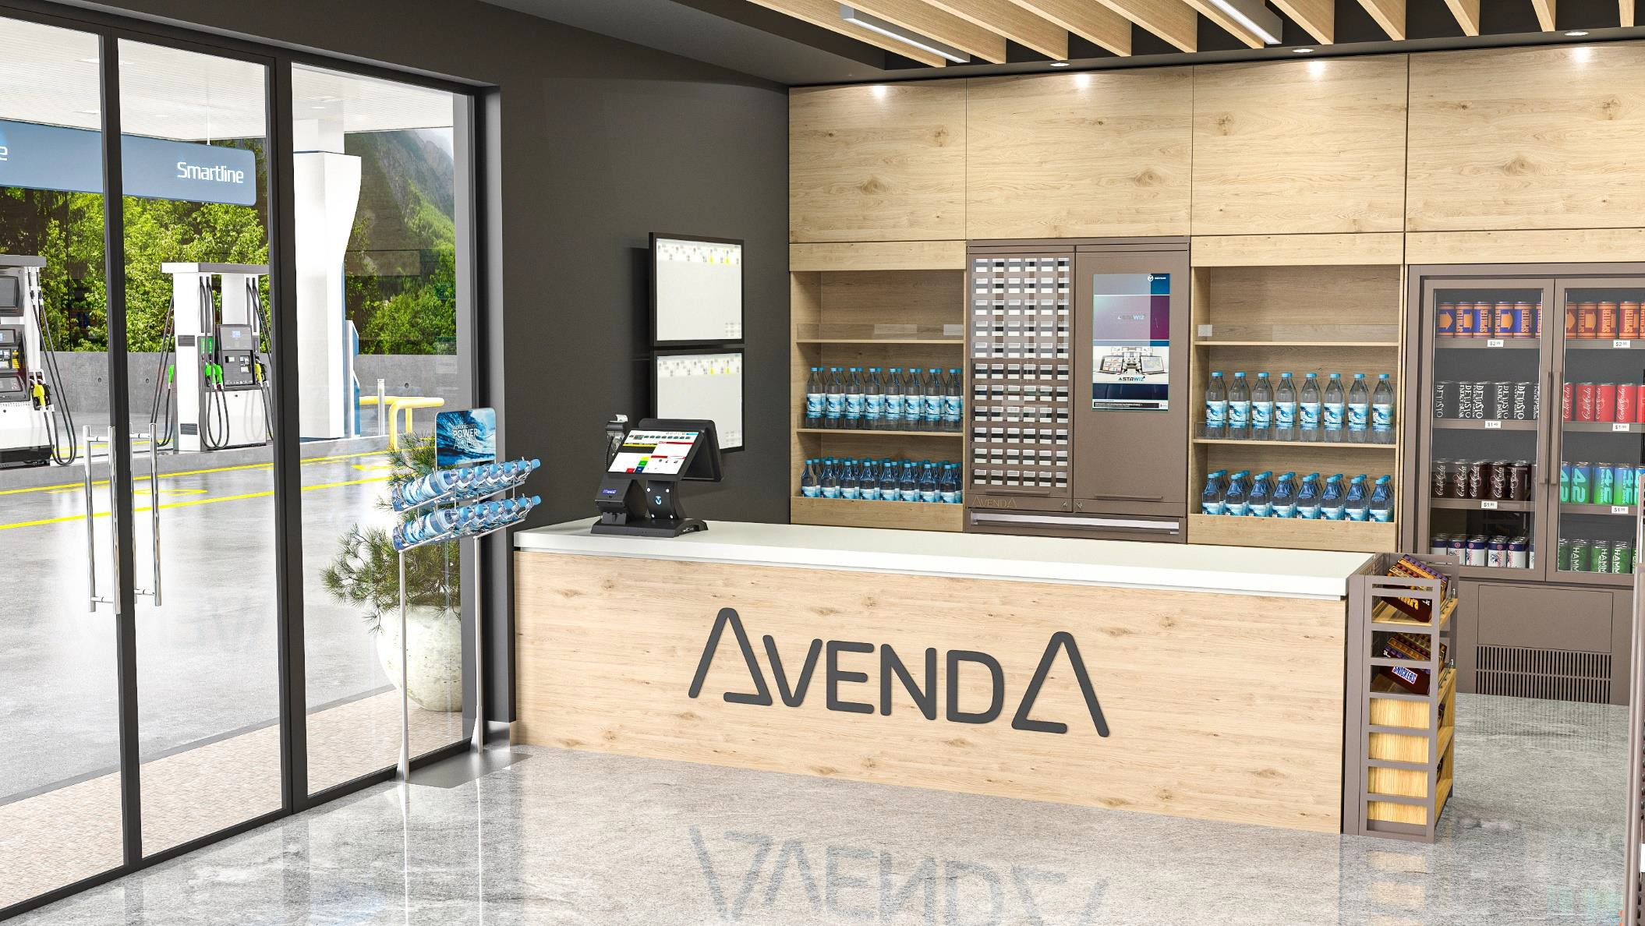

Automat Technologies Solutions

Slide 24

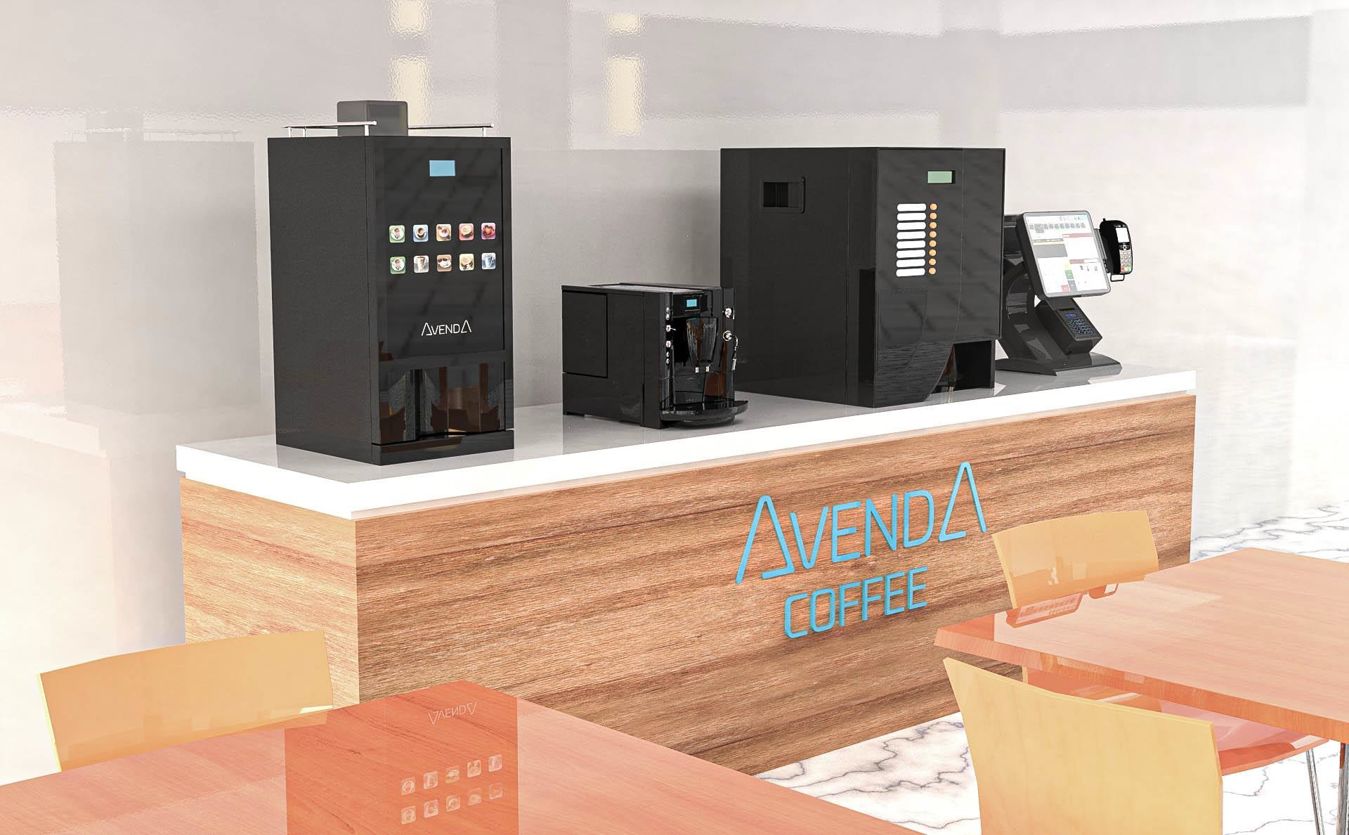

AVENDA COFFEE MACHINE\\
Automat Technologies Solutions

Slide 25
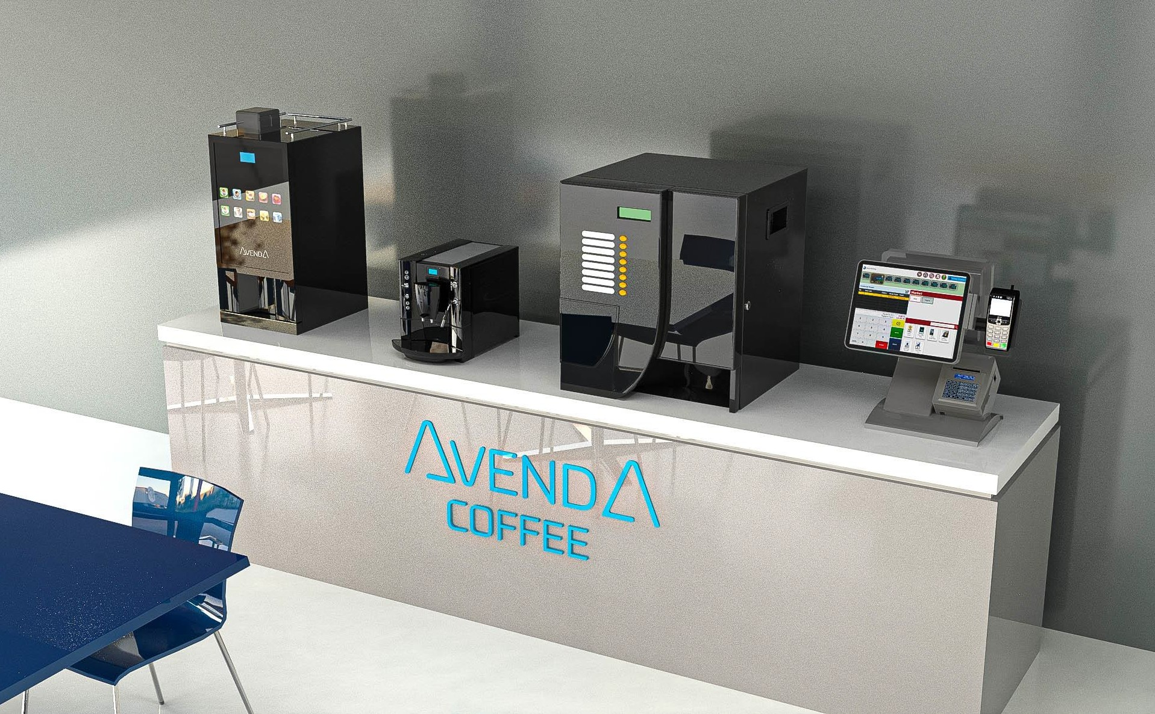


HOT DRINK AUTOMATION
Automat Technologies Solutions
Gloria I

Slide 26

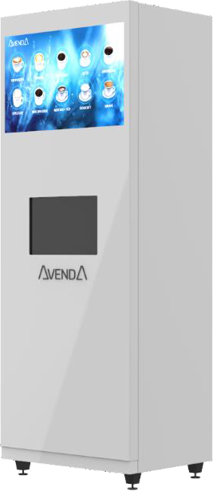

HOT DRINK AUTOMATION
Gloria II
Automat Technologies Solutions
Key Features of Our Commercial Coffee Machines
Always Fresh Coffee: Equipped with a built-in coffee grinder for freshly ground coffee with every cup, ensuring a premium coffee experience every time.
Inventory Control System: Integrated inventory management to track coffee bean levels and other supplies, ensuring uninterrupted service.
User-Friendly Interface: A touch-sensitive, intuitive screen makes operation seamless and accessible for both staff and customers.
Automatic, Secure Product Delivery: A fully automated and secure system for product delivery, designed for reliability and ease of use.
Advertising Screen: A built-in screen for promotional content and advertisements, allowing you to engage customers and boost sales.

Slide 27
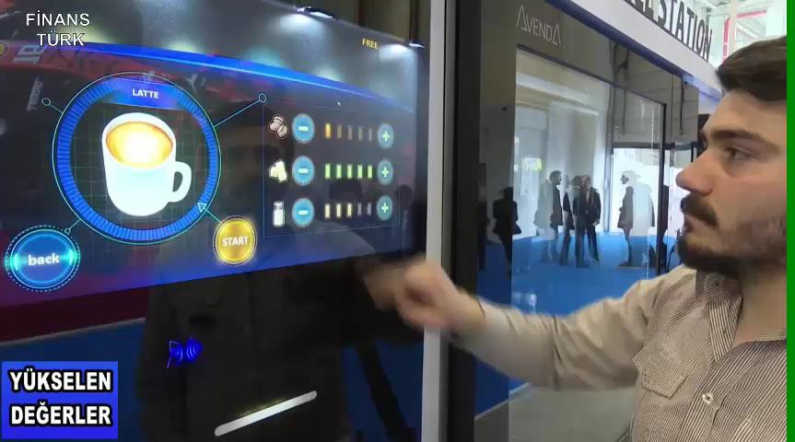

Slide 28
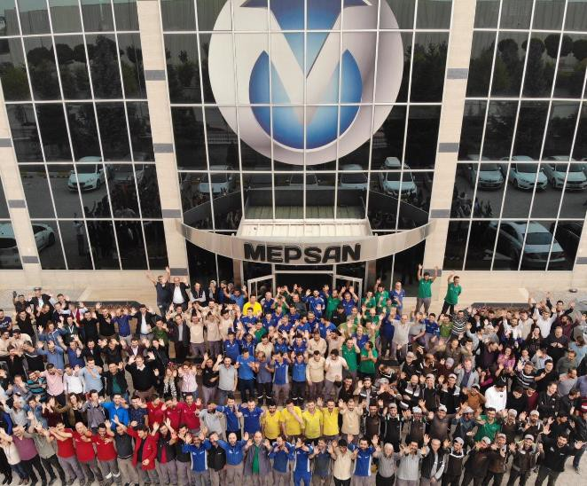
MEPSAN Family
We invite you to visit Our State-of-the-Art Production Facilities and meet with our dynamic, talented team driving our success.
Discover firsthand how we are shaping the future of energy technology in one of Europe’s most advanced manufacturing environments.
We take great pride in what we do, and we want to share this pride with you. Together, let’s build a future fueled by innovation.

Slide 29
Thank You!

